Slide 1
TE 271: Analog Communication Systems Lecture 3 Examiner: M. S. Ellis, PhD smellis.coe@knust.edu.gh 057 904 7591
September 18th , 2016

Slide 2
Reference material
A. Yadav, “Analog Communication Systems”, University Science Press, New Delhi, 2008.
S. Sharma, “Communication Engineering”, First Ed., S.K. Kataria & Sons, New Delhi, 2011.
T. G. Thomas, “Analog Communication”, McGraw hill, New Delhi, 2007.

Slide 3
AMPLITUDE Modulation
“if the amplitude of carrier is varied according to the instantaneous value of the message signal. The modulation is called amplitude modulation”
A carrier signal is generally a sinusoidal wave with the expression: Vc = Vc cos (ωct + Ө) ….(1)
In amplitude modulation, the focus is on modifying the amplitude of the carrier signal as the frequency and phase remain unchanged
The carrier equation then becomes:
Vc = Vc cos ωct …..(2)
Assuming the baseband signal (modulating signal) is sinusoidal as well, then
m(t) = Vm cos ωmt ……(3)
Now amplitude modulation says the carrier is varied according to the instantaneous value of the baseband signal; then the general expression becomes: V = V cos ωct <---- (carrier wave freq unchanged) …….(4)

Slide 4
V = Vc + m(t)
= Vc + Vm cos ωmt ……(5)
Substituting eqtn (5) in eqtn (4) becomes:
V = {Vc + m(t)} cos ωct
= Vc cos ωct + m(t)cos ωct ……...(6)
= Vc cos ωct + Vm cos ωmt * cos ωct
= Vc cos ωct + maVc cos ωmt * cos ωct …..(7)
Where, ma Vc = Vm,
And ma = Vm / Vc ………… (8)
This ratio (Vm / Vc) is called Modulation index. Maximum value of ma is 1, why ??

Slide 5
V = Vc cos ωct + (Vm cos ωmt * cos ωct)
= Vc cos ωct + (maVc)/2 {cos (ωc + ωm)t + cos (ωc - ωm)t}
From the identity Cos x * Cos y = ½ { cos (x + y) + cos (x – y)} …...(9)
V = Vc cos ωct + (maVc)/2 {cos (ωc + ωm)t + cos (ωc - ωm)t} …(10)
1st 2nd 3rd
Equation (10) can be separated into 3 terms:
1st term represents the unmodulated carrier signal
2nd term represents the upper side band with a magnitude of Vc/2
3rd term represents the lower side band with amplitude Vc/2

Slide 6
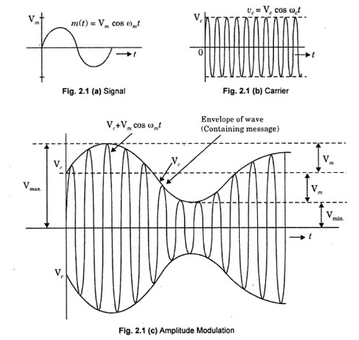

Slide 7
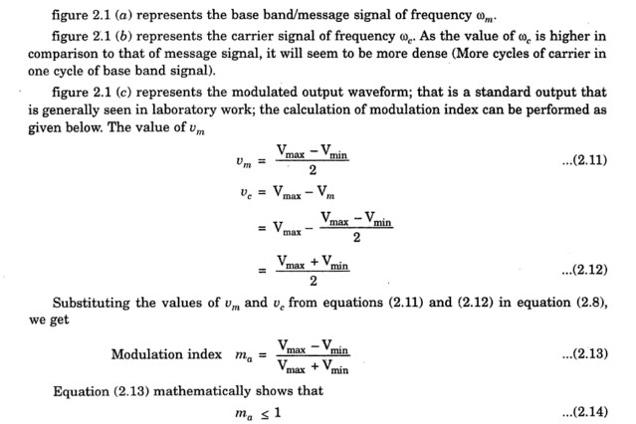
Can modulation Index be greater than 1 ?? If it can, What happens when it is greater than 1 ??

Slide 8
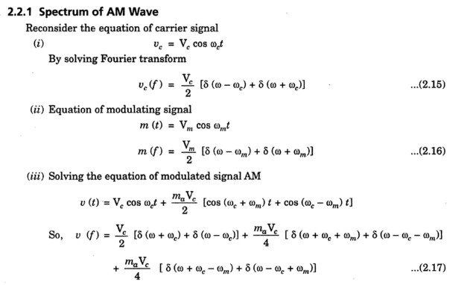
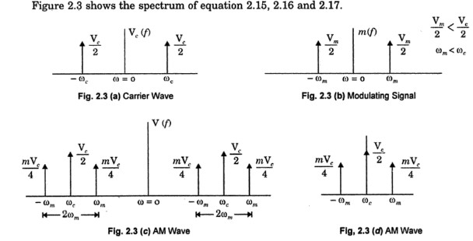
Solving by Fourier transform reveals the components of the carrier, modulating, and modulated AM waves
Fig. 2.3 (a) and (b) show the spectrum of carrier and modulating signals respectively, according to the Fourier transform
Fig. 2.3 (c) shows the modulated AM wave spectrum
Practically, negative frequencies are of no use hence Fig. 2.3 (d) shows the useful AM wave spectrum
It shows that the transmission bandwidth of the AM signal is: BAM = 2ωm
What happens when the message signal isn’t sinusoidal ??

Slide 9
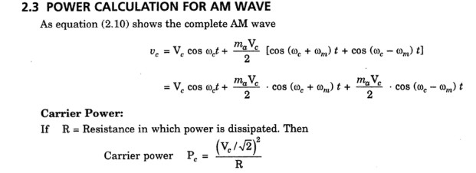
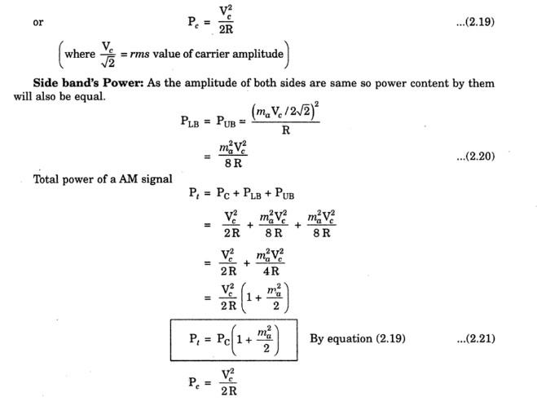

Slide 10
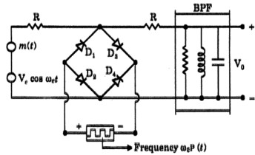
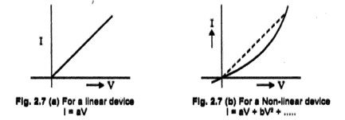
Methods of Generation of AM
Methods of generating AM can categorized into 2:
Linear time-variant circuits
Non –Linear circuits
LINEAR TIME VARIANT CIRCUITS:
A system that is time-invariant cannot be used to generate AM. Why ??
An example of a time-variant linear system is a Switching circuit (or Chopper circuit or Ring modulator) shown on the upper right
NON-LINEAR CIRCUITS:
A non linear device can also produce AM
For a non-linear device (e.g. shown on the lower right), current does not only depend upon the first power of voltage but also on the higher order of voltage
Chopper (Switching or ring) Circuit
Linear and non-linear current/voltage relation

Slide 11
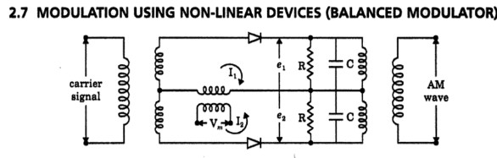
Methods of Generation of AM…….
Here the diode is used as an non-linear device. Other non linear devices like transistors can also be used
Two halves of the circuit have been arranged such that I1 and I2 are opposing each other. So the net current at output is I1 - I2. The R-C circuit forms the band pass filter tuned at ωc
This type of arrangement is called balanced circuit hence the name Balanced Modulator
COMPARE THE NON-LINEAR DEVICE METHOD AND THE CHOPPER METHOD

Slide 12
Demodulation of AM
In demodulation, we require a frequency translation such that the message signal translated at carrier frequency ωc comes back at frequency ωm
In demodulation, the required frequency is ωm so all other higher frequencies must be filtered out
This can be achieved by using a low pass filter having a cut-off frequency of ωc
Demodulation is essentially a reverse process of modulation

Slide 13
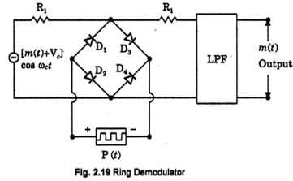
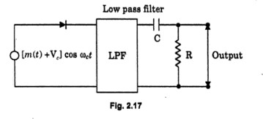
Demodulation of AM using Linear-Time Variant System (Rectifier Type) Detector
Just as in modulation, demodulation can be done using a linear time-variant detector
AM signal is applied at the input and a low pass filter at the outer stage with ωc cut-off frequency
A similar operation can be easily performed using a ring modulator

Slide 14
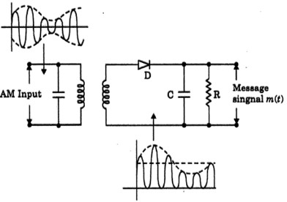
Demodulation of AM using Linear-Time Varying System (Envelope Detector)
Simplest way of demodulating AM
Here, the negative half of the AM wave is absent in the output of the diode
Capacitor ‘C’ and resistance ‘R’ perform the filtering
Voltage across capacitor tries to follow the envelope of signal. Hence the envelope of AM signal is nothing but the message signal (hence the name envelope detector).
Setbacks with envelope detection ??
Negative peak clipping
Diagonal clipping (at high freq, diode becomes reactive, rate of slope too fast for ‘C’ and ‘R’)

Slide 15
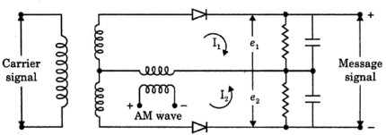
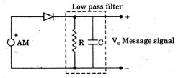
Demodulation of AM using Non-Linear devices)
Again, the same circuit for modulation is used for demodulation; now with the input being the AM signal and output being a low pass filter.

